Slide 1
7FNCE040W
Business Analytics
WEEK 7 (Bite 1 to 3)

Slide 2
Unstructured Data Analytic Techniques Cluster Analysis.

Slide 3
Today’s Schedule
Cluster Analysis
In-class Exercise

Slide 4
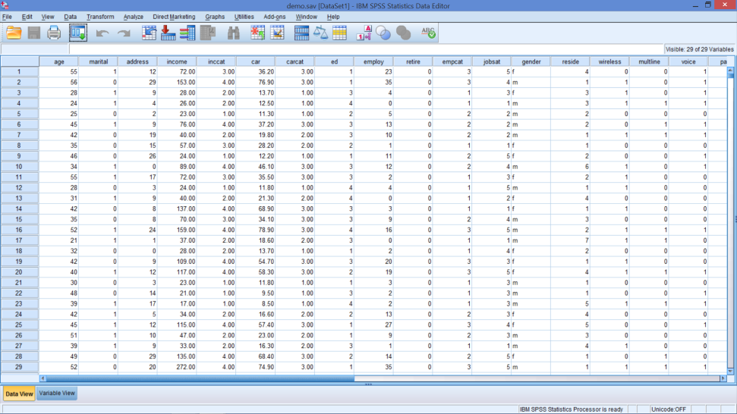

Factor versus Cluster Analyses
Factor – Group Variables
Cluster – Group Cases
Factor 1
Factor 2
Factor 3
Factor 4
Cluster 1
Cluster 2
Cluster 3
Notes:
As A reminder
Factor analysis groups variables (columns in SPSS)
Cluster Analysis Groups observations (rows in SPSS)

Slide 5

Market Segmentation
What is it?
process of dividing a market into distinct subsets of customers.
Why segment?
Criteria for good segmentation
E.g creating 4 Ps can be more efficient & effective
On what basis?
Many criteria-demographics/psyhographics
Criteria for good segmentation
Heterogeneity / homogeneity
Parsimony
Accessibility
Notes:
Market segmentation is the process of dividing a market into distinct subsets of customers.
Criteria for good segmentation
Heterogeneity / Homogeneity
Members are different between
Members are similar within
Parsimony
Small set of groupings (3 - 8)
Each set of substantial size
Accessibility
Reach & identify segments
Using observable characteristics (descriptors)

Slide 6
Segmentation (for Carpet Fibers)
Preference Ratings for one respondent:
Consumer Values
.
.
.
.
.
.
.
.
.
.
.
.
.
.
.
.
.
.
.
.
.
.
.
.
.
Strength
(Importance)
.
.
.
.
.
.
.
.
.
.
. .
.
.
.
.
.
.
.
.
.
.
.
.
.
Water Resistance
(Importance)
Notes:
26
26

Slide 7
Segmentation (for Carpet Fibers)
Preference Ratings for one respondent:
Consumer Values
Distance between person and center
.
.
.
.
.
.
.
.
C
.
.
A
.
.
.
.
.
.
.
.
.
.
.
.
.
.
.
Strength
(Importance)
Distance between
segments C and D
.
.
.
.
.
.
.
B
. .
.
.
.
.
.
D
.
.
.
.
.
A,B,C,D:
Location of
segment centers.
Typical members:
A: Heavy traffic / Inside
B: Light traffic / Inside
C: Heavy traffic / Outside
D: Light traffic / Outside
.
.
.
.
.
.
Water Resistance
(Importance)
Notes:
26
26

Slide 8
Questions Cluster Analysis Answers
Do distinct segments exist?
Need to determine whether segmentation is worthwhile
What characteristics distinguish the segments?
Identify the features of the clusters
Explain how the clusters can be used in Marketing activities/Banking/Finance Activities
Determine if different clusters exist
If so, how many

Slide 9
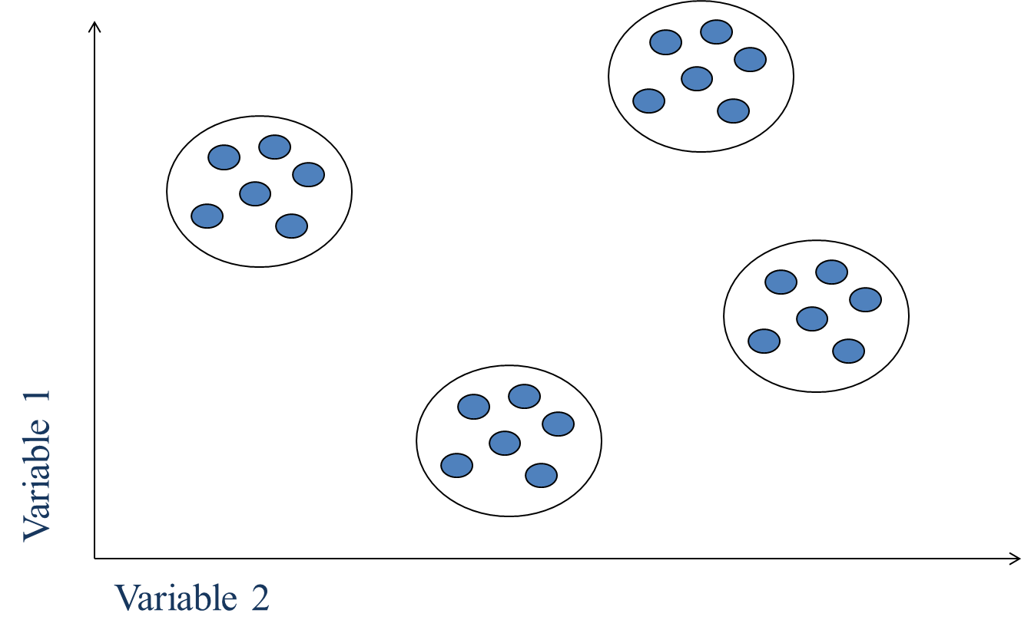
Ideal Clustering Situation
Notes:
This is the ideal situation – we know exactly how many clusters and who is in each one.
However , this is highly unlikely.

Slide 10
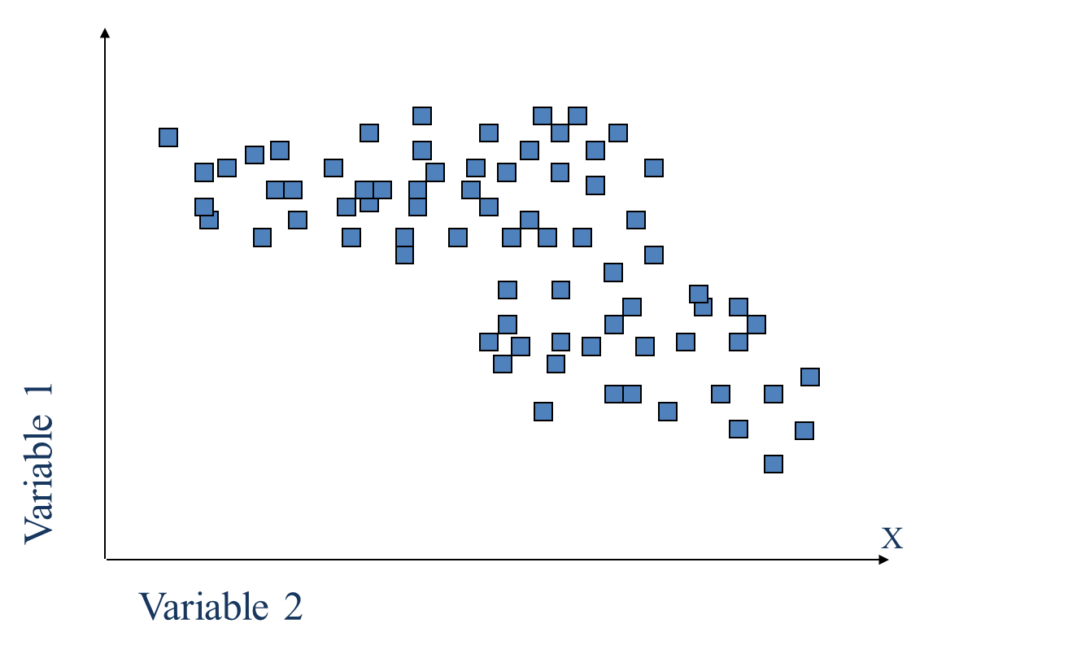
Typical Clustering Situation
Notes:
?how many clusters to create
? We don’t know the boundaries between each cluster.

Slide 11
Conducting Cluster Analysis
1
2
3
6
4
5
Formulate the problem
Select a distance measure
Select a clustering procedure
Decide on the number of clusters
Interpret and profile the clusters
Assess the validity of the clustering
Notes:
Here are terms that are relevant for cluster analysis:
Agglomeration schedule: An agglomeration schedule gives information on the objects or cases being combined at each stage of a hierarchical clustering process.
Cluster centroid: The cluster centroid is the mean values of the variables for all the cases or objects in a particular cluster.
Cluster centers: The cluster centers are the initial starting points in nonhierarchical clustering. Clusters are built around these centers, or seeds.
Cluster membership: Cluster membership indicates the cluster to which each object or case belongs.
Dendrogram: A dendrogram, or tree graph, is a graphical device for displaying clustering results. Vertical lines represent clusters that are joined together. The position of the line on the scale indicates the distances at which clusters were joined. The dendrogram is read from left to right.
Distances between cluster centers: These distances indicate how separated the individual pairs of clusters are. Clusters that are widely separated are distinct, and therefore desirable.

Slide 12
Conducting Cluster Analysis
1
2
3
6
4
5
Formulate the problem
Select a distance measure
Select a clustering procedure
Decide on the number of clusters
Interpret and profile the clusters
Assess the validity of the clustering
Notes:
First Step – Formulate the problem.
Before starting the cluster analysis, think about the managerial or
marketing problem you are trying to address.

Slide 13
What variables to include?
Representative of the objective
Impact of multicollinearity
Notes:
Perhaps the most important part of formulating the clustering problem is selecting the variables on which the clustering is based.
Inclusion of even one or two irrelevant variables may distort an otherwise useful clustering solution.
Basically, the set of variables selected should describe the similarity between objects in terms that are relevant to the marketing research problem.
The variables should be selected based on past research, theory, or a consideration of the hypotheses being tested. In exploratory research, the researcher should exercise judgment and intuition.
When variables used in clustering are collinear, some variables get a higher weight than others. If two variables are perfectly correlated, they effectively represent the same concept. But that concept is now represented twice in the data and hence gets twice the weight of all the other variables. The final solution is likely to be skewed in the direction of that concept, which could be a problem if it’s not anticipated.

Slide 14
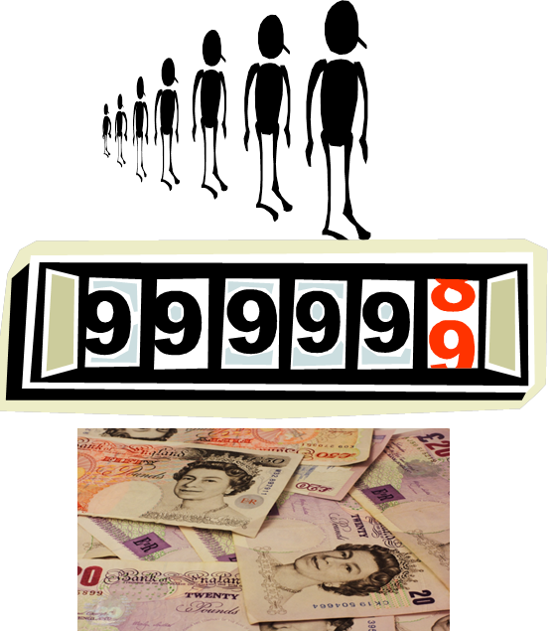
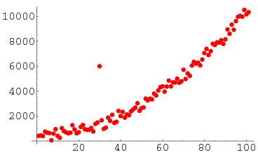
Are there any data problems?
Outliers
Different Units
Notes:
It is desirable to eliminate outliers (cases with atypical values).
Is there anyone who is not in the market?
Is there anyone who is so different that they would alter the results?
Solution: Delete those who do not belong in analysis
If the variables are measured in vastly different units, the clustering solution will be influenced by the units of measurement. In these cases, before clustering respondents, we must standardize the data by rescaling each variable to have a mean of zero and a standard deviation of one.
Notes on standardization:
If the variables’ measurement scales are roughly of the same magnitude, it might be best not to standardize them. Standardization reduces the differences between variables and cluster analysis is trying to exploit these differences, so there are costs to standardization.
If the variables are measured on widely differing units. Standardization is needed to prevent the variables measured in large units from dominating the cluster solution.

Slide 15
Conducting Cluster Analysis
1
2
3
6
4
5
Formulate the problem
Select a distance measure
Select a clustering procedure
Decide on the number of clusters
Interpret and profile the clusters
Assess the validity of the clustering
Notes:
Choice of a clustering method and choice of a distance measure are interrelated. For example, for many of the hierarchical methods, use Euclidean distance; squared Euclidean distances should be used with the Ward's and centroid methods. Several nonhierarchical procedures also use squared Euclidean distances.
Use of different distance measures may lead to different clustering results. Hence, it is advisable to use different measures and compare the results.

Slide 16
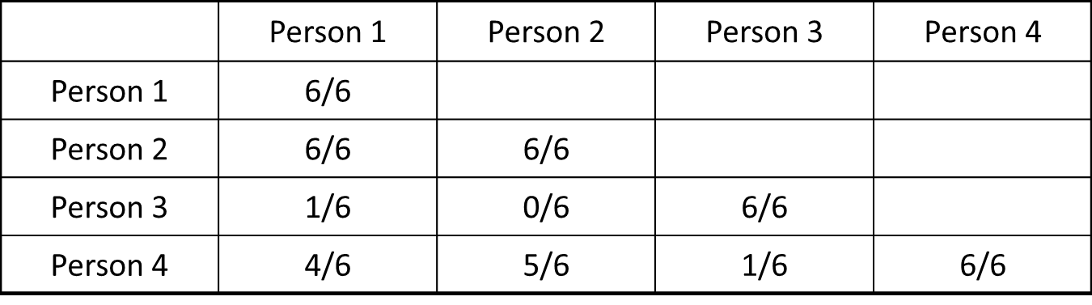
Matching Measure: An Example
Number of agreements in a survey
What if 2 segments?
What if 3 segments?
What can’t this type of matching capture?
Notes:
21
21
For nominal data, these types of analyses are viable for assessing similarities.
2 segments: 1, 2, & 4 in one segment and 3 in another
3 segments: 1 & 2 in one, person 4 in one, and 3 in the third
What if not nominal data?

Slide 17
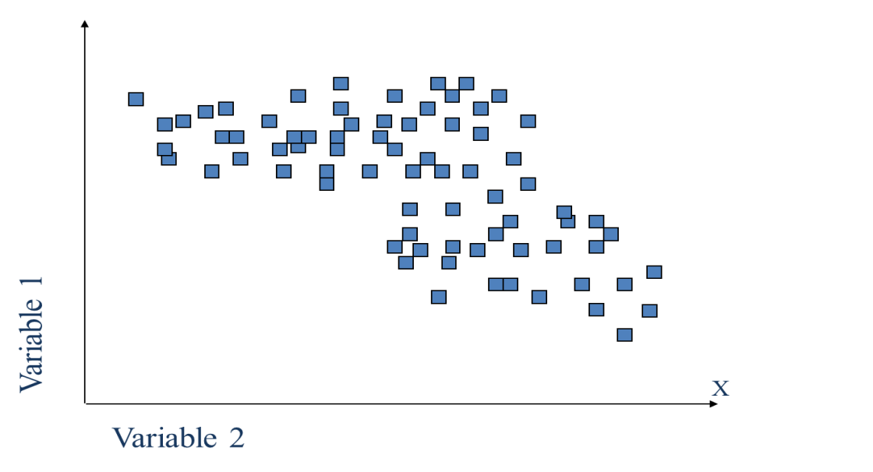
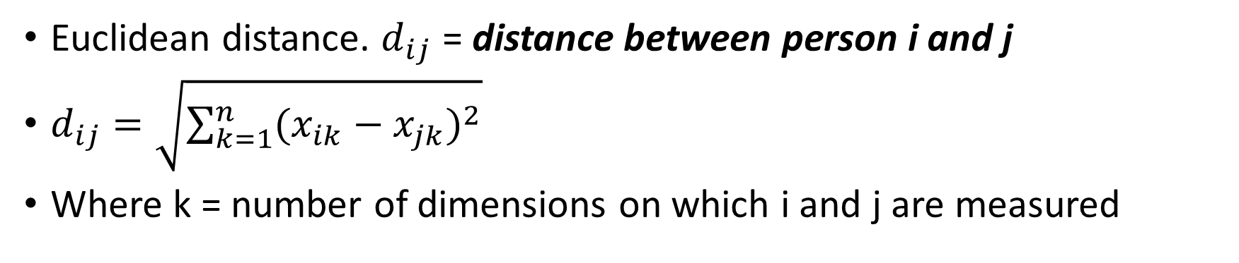
Distance Between Objects
Euclidean distance. $d_{ij}$ = distance between person i and j
$d_{ij}=\sqrt{\sum_{k=1}^{n}{{(x_{ik}−x_{jk})}^{2}}}$
Where k = number of dimensions on which i and j are measured
Notes:
For interval & ratio data - imagine each consumer on map
Location is dependent on many product features and needs (axes)
The most commonly used measure of similarity is the Euclidean distance or its square. The Euclidean distance is the square root of the sum of the squared differences in values for each variable.
Group objects that are close together.
Other distance measures are also available.
The city-block or Manhattan distance between two objects is the sum of the absolute differences in values for each variable.
The Chebychev distance between two objects is the maximum absolute difference in values for any variable.

Slide 18
Conducting Cluster Analysis
1
2
3
6
4
5
Formulate the problem
Select a distance measure
Select a clustering procedure
Decide on the number of clusters
Interpret and profile the clusters
Assess the validity of the clustering
Notes:
A number of clustering methods exist for forming groups of objects.
The objective underlying each method is the same – to assign objects to groups so that there will be as much similarity within the groups and as much difference between the groups as possible.
The different methods can produce widely divergent results for the same data, and none of the methods is yet accepted as the “best” under all circumstances.
The researcher must be familiar with various methods and choose the one that is most compatible with the research project’s goals.

Slide 19
Popular Clustering Procedures
Procedures
Hierarchical
Linkage
Non-hierarchical
Single
Average
Complete
K-means
Ward’s
Centroid
Notes:
Hierarchical clustering is characterized by the development of a hierarchy or tree-like structure.
Hierarchical methods can be agglomerative or divisive.
Use when you don’t know how many segments
Agglomerative clustering starts with each object in a separate cluster. Clusters are formed by grouping objects into bigger and bigger clusters based on similarity. This process continues until all objects are members of a single cluster.
Agglomerative methods are commonly used in marketing research.
Divisive clustering starts with all the objects grouped in a single cluster. Clusters are divided or split based on dissimilarity until each object is in a separate cluster.
Non-hierarchical clustering (partitioning) procedures
Based on predetermined number of segments.
First assign or determine one of more cluster centers, and then group all objects within a specified threshold value from the centers.

Slide 20
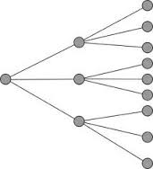
Hierarchical Methods
Don’t know how many clusters
Many different algorithms
Pluses & minuses to each
Output used for number of clusters
Dendrogram
Means Table
Notes:
Different Hierarchical Methods:
Single-linkage is probably the most versatile algorithm, but poorly delineated cluster structures within the data produce unacceptable snakelike “chains” for clusters.
Complete linkage eliminates the chaining problem, but only considers the outermost observations in a cluster, thus impacted by outliers.
Average linkage is based on the average similarity of all individuals in a cluster and tends to generate clusters with small within-cluster variation and is less affected by outliers.
Centroid linkage measures distance between cluster centroids and like average linkage, is less affected by outliers.
Ward’s is based on the total sum of squares within clusters and is most appropriate when the researcher expects somewhat equally sized clusters. But it is easily distorted by outliers.

Slide 21
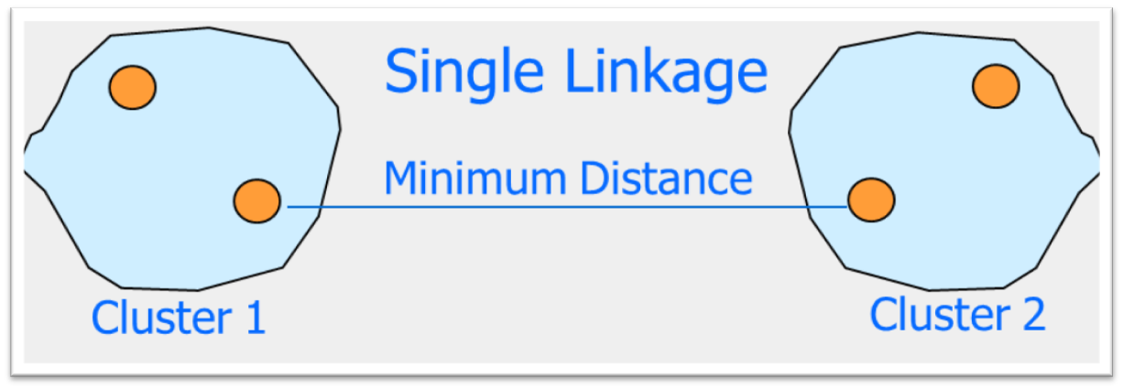
Single Linkage – Nearest Neighbor
Smallest Minimum
Notes:
The single linkage method is based on minimum distance, or the nearest neighbor rule. At every stage, the distance between two clusters is the distance between their two closest points
Determine the smallest distance between members of each segment
The two clusters with the smallest minimum pairwise distance
Idea is that new member will be
Similar to at least one existing member
More similar than all potential new members
May result in “chaining”

Slide 22
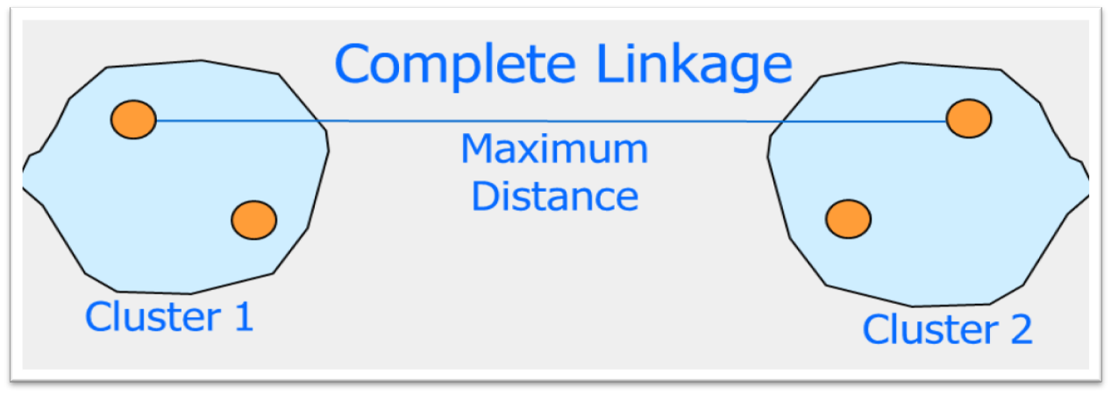
Complete Linkage – Farthest Neighbor
Smallest Maximum
Notes:
The complete linkage method is similar to single linkage, except that it is based on the maximum distance or the furthest neighbor approach. In complete linkage, the distance between two clusters is calculated as the distance between their two furthest points.
Determine the largest distance between members of each segment
The two clusters with the smallest maximum pairwise distance
Idea is that new member will be “close” to all members of cluster

Slide 23
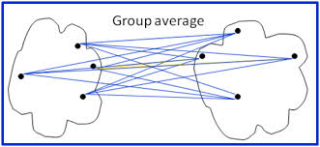
Average Linkage – Between Groups
Smallest Average
Notes:
The average linkage method also works similarly. However, in this method, the distance between two clusters is defined as the average of the distances between all pairs of objects, where one member of the pair is from each of the clusters
Calculate the average distance between each cluster (based on all member pairs)
Join the cluster with the smallest average
Idea is that new member will be “close” to an average member of cluster
Good compromise of previous two linkage options

Slide 24
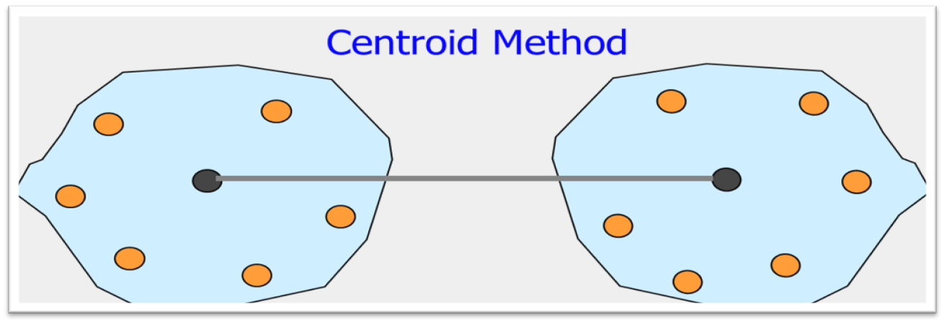
Centroid Clustering
Notes:
The similarity of two clusters is determined by the closeness of the centroid.
Measure the distance between all the centroids
Group the closest centroids
The centre point moves quite a bit with each iteration so the clusters can overlap

Slide 25
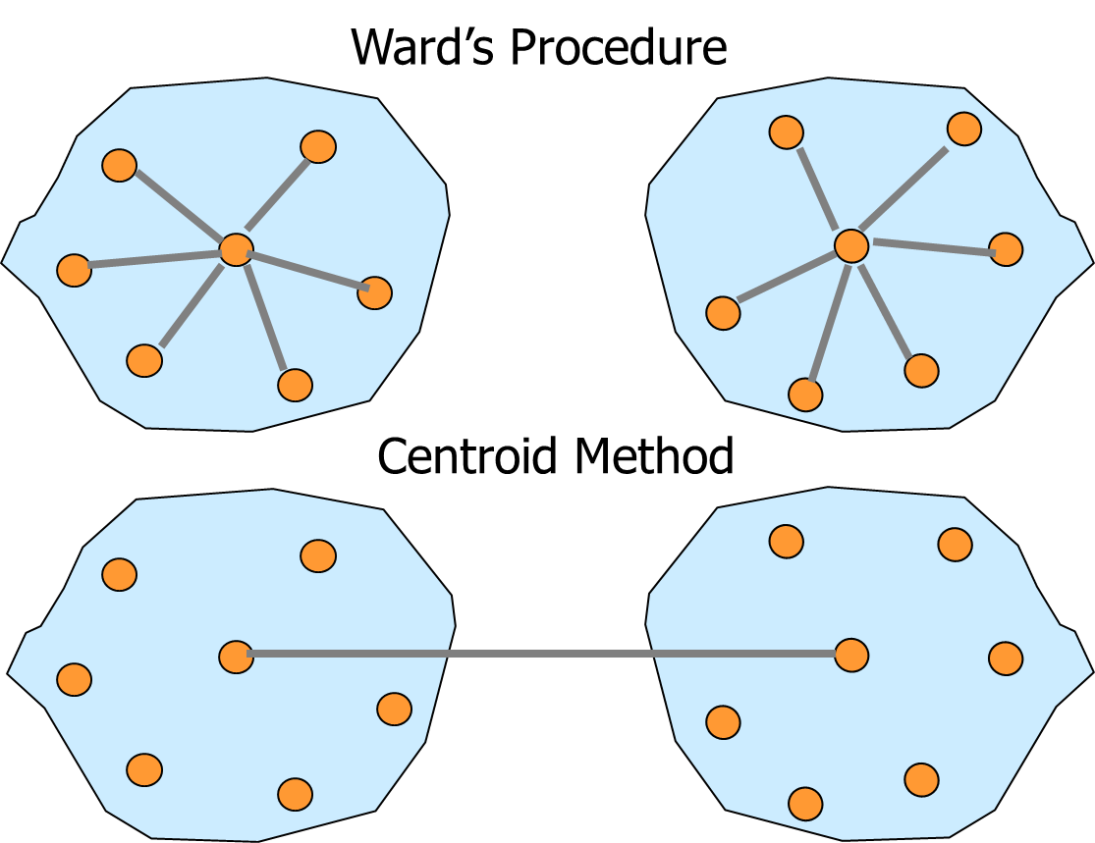
Ward’s Method
Notes:
A commonly used variance method is the Ward's procedure. For each cluster, the means for all the variables are computed. Then, for each object, the squared Euclidean distance to the cluster means is calculated. These distances are summed for all the objects. At each stage, the two clusters with the smallest increase in the overall sum of squares within cluster distances are combined.
Measure the variance
For each possible new entrant
Given the appropriate center point of segment
Add new member that provides lowest variance
Idea: Lower variance implies more similarity across all members

Slide 26
Conducting Cluster Analysis
1
2
3
6
4
5
Formulate the problem
Select a distance measure
Select a clustering procedure
Decide on the number of clusters
Interpret and profile the clusters
Assess the validity of the clustering
Notes:
Theoretical, conceptual, or practical considerations may suggest a certain number of clusters.
In hierarchical clustering, the distances at which clusters are combined can be used as criteria. This information can be obtained from the agglomeration schedule or from the dendrogram.
The relative sizes of the clusters should be meaningful.

Slide 27
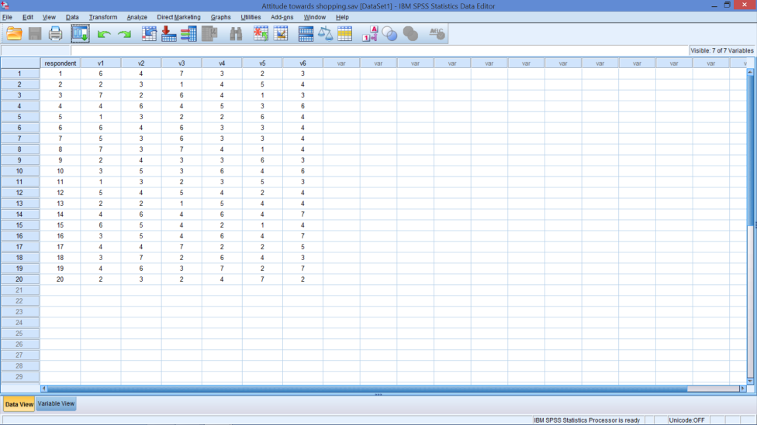
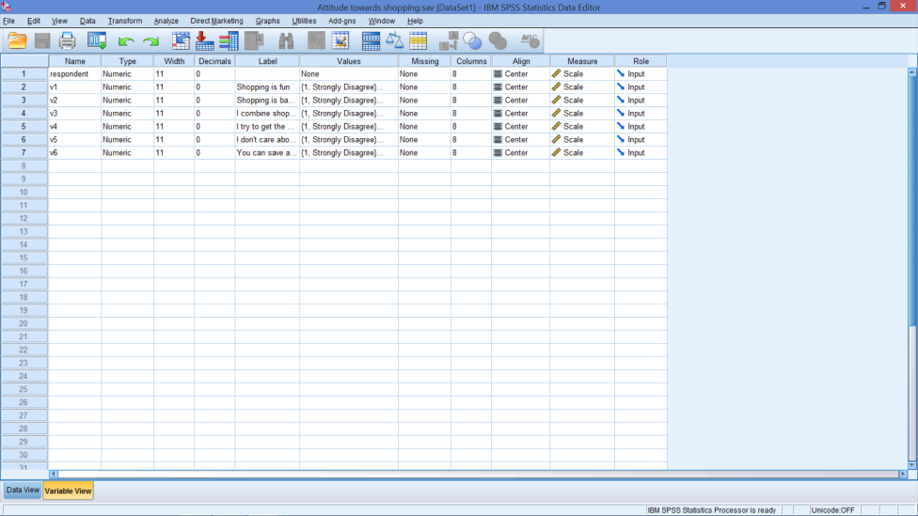
Attitudinal Data For Clustering
Notes:
Open Attitude towards shopping.sav
Considering clustering consumers based on attitudes toward shopping. Based on past research, six attitudinal variables were identified. Consumers were asked to express their degree of agreement with the following statements on a 7-point scale (1 = Strongly disagree, 7 = Strongly agree).
V1: Shopping is fun.
V2: Shopping is bad for your budget.
V3: I combine shopping with eating out.
V4: I try to get the best buys when shopping.
V5: I don’t care about shopping.
V6: You can save a lot of money by comparing prices.

Slide 28
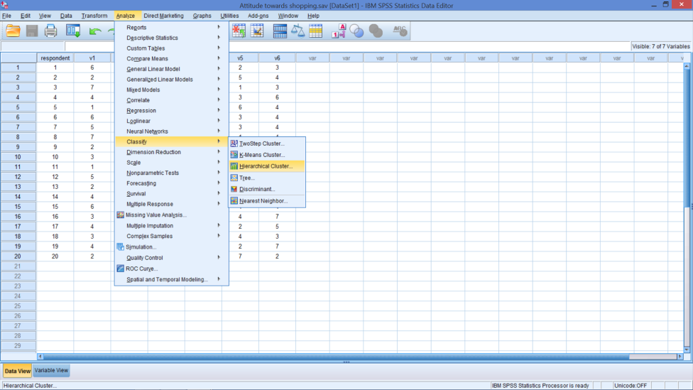
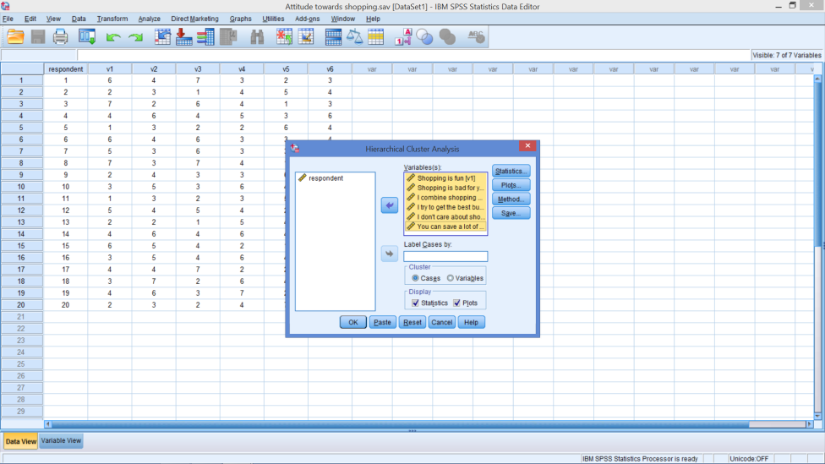
Cluster Analysis
Notes:
Analyze → Classify → Hierarchical Cluster…
Move V1 – V6 to variables box

Slide 29
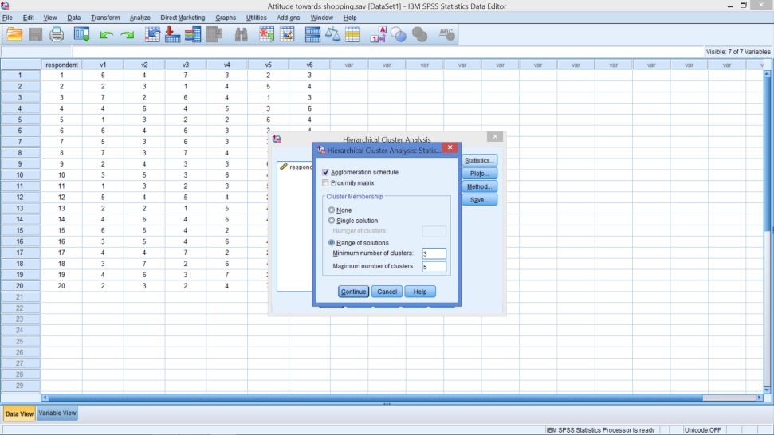
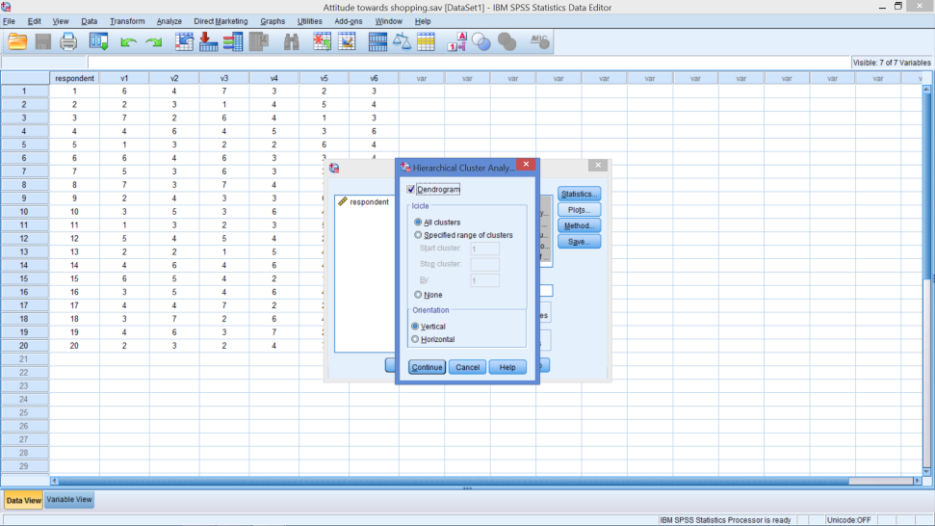
Cluster Analysis
Statistics Box
Plots Box
Notes:
Statistics Box
Be sure agglomeration schedule is ticked
Tick Range of Solutions then Insert:
Min = 3
Max = 5
Plots Box
Tick Dendrogram

Slide 30
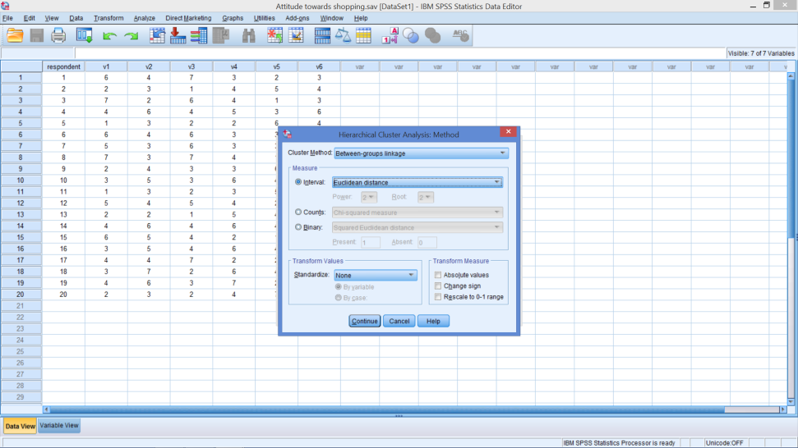
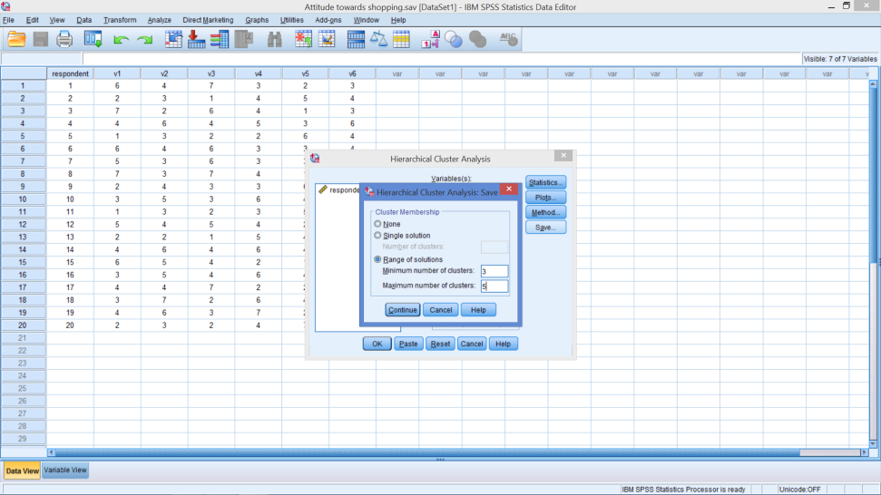
Cluster Analysis
Method Box
Save Box
Notes:
Method Box
Between Groups – Average Linkage
Distance: Euclidean Distance (Not squared Euclidean distance)
Note if variables are not on same, or at least similar, scales then:
Standardized
Select Z scores
By variable
Don’t need to do it for this example
Save Box
Tick Range of Solutions
Insert min = 3 and max = 5

Slide 31
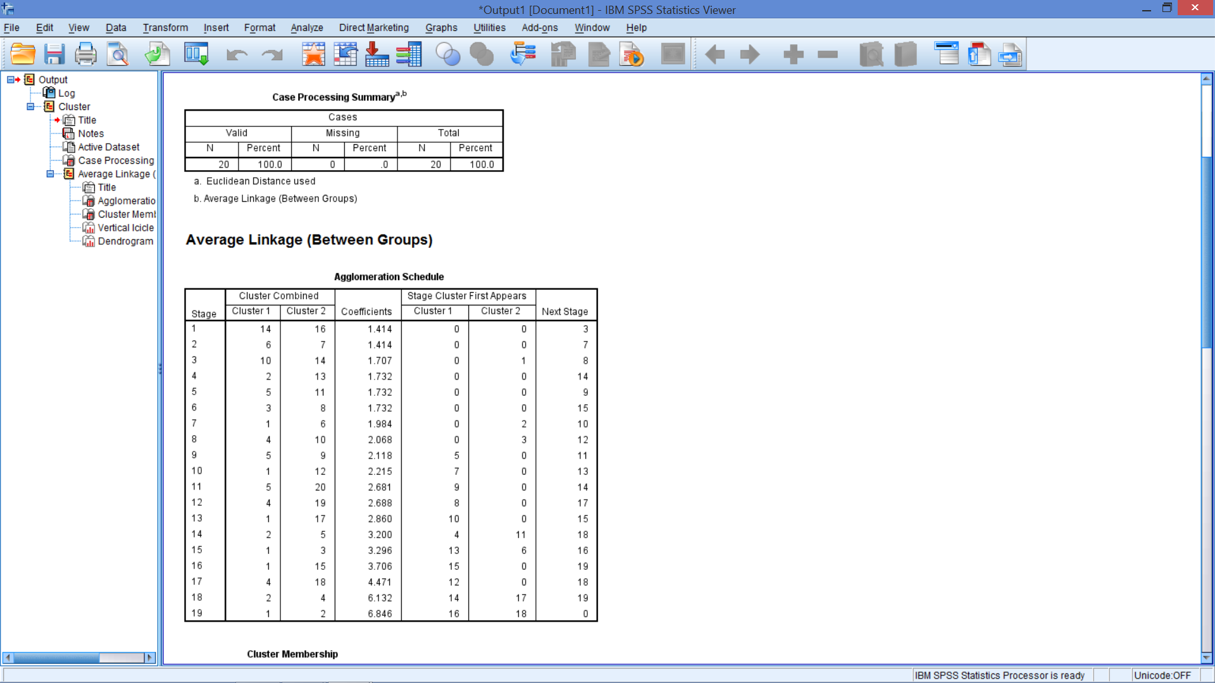
Summary
Notes:
In the this table, you can see verification of the clustering method used and how distance is measured.

Slide 32
Fusion Coefficients
Notes:
The agglomeration schedule gives information on the objects or cases being combined at each stage of a hierarchical clustering process.
The Fusion Coefficient is the distance between the objects and / or clusters at the point they are joined.
At stage 1: Objects 14 and 16 are the first to be joined, going from 20 to 19 clusters, at a distance of 1.414.
At stage 2: Objects 6 and 7 are joined, going from 19 to 18 clusters, at a distance of 1.414.
At stage 3: Object 10 is joined to the cluster of 14 and 16, going from 18 to 17 clusters, at a distance of 1.707.
Etc.

Slide 33
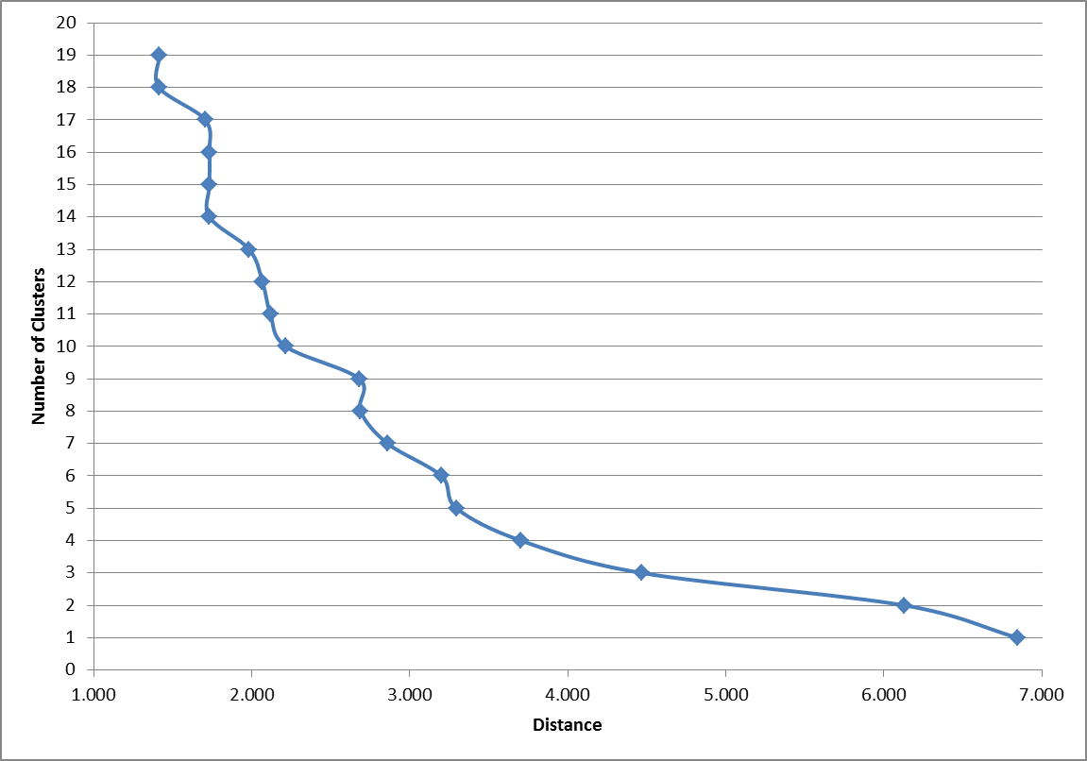
Clusters vs. Fusion Coefficients
5 Clusters is Maximum
Notes:
This plot is not provided by SPSS, but the data are provided and can be used in EXCEL to create the plot.
Like the scree plot, look for large jumps in the distances between joined clusters, this is indicated by areas where the curve flattens out
Where the curve is steep, there is not much distance between clusters – indicating similarity
Where the curve is flatter, there are greater distances between clusters – indicating dissimilarity
The chart shows that 5 is maximum number
Between 5 and 6 clusters there is little very distance, indicating they are similar and could be grouped
Between 4 and 5 clusters, the distance is getting larger – longer lines – so there may be no need to go beyond 5.

Slide 34
Deciding on Number of Clusters
Dendrogram
Means Table

Slide 35
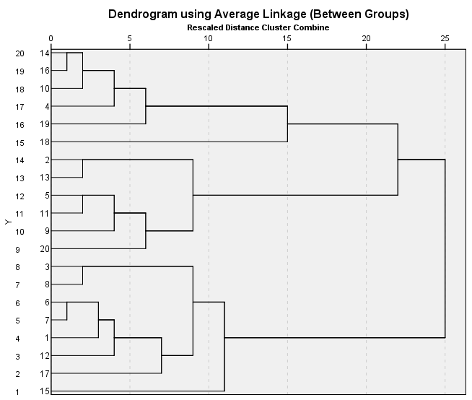
Dendrogram
Notes:
Notice that the lines do not cross – once an object is included in a cluster, it is never removed. This is true of all linkage methods, but not all hierarchal methods.
From left to right, the clusters become larger until all are in one cluster.
From right to left, all the objects are in one cluster and split apart as differences (distances are recognized).

Slide 36
Dendrogram – 2 Segments?
Notes:
Notice that the lines do not cross – once an object is included in a cluster, it is never removed. This is true of all linkage methods, but not all hierarchal methods.
From left to right, the clusters become larger until all are in one cluster.
From right to left, all the objects are in one cluster and split apart as differences (distances are recognized).

Slide 37
Dendrogram – 3 Segments?
Notes:
Notice that the lines do not cross – once an object is included in a cluster, it is never removed. This is true of all linkage methods, but not all hierarchal methods.
From left to right, the clusters become larger until all are in one cluster.
From right to left, all the objects are in one cluster and split apart as differences (distances are recognized).

Slide 38
Dendrogram – 4 Segments?
Notes:
Notice that the lines do not cross – once an object is included in a cluster, it is never removed. This is true of all linkage methods, but not all hierarchal methods.
From left to right, the clusters become larger until all are in one cluster.
From right to left, all the objects are in one cluster and split apart as differences (distances are recognized).

Slide 39
Dendrogram – 5 Segments?
Notes:
Notice that the lines do not cross – once an object is included in a cluster, it is never removed. This is true of all linkage methods, but not all hierarchal methods.
From left to right, the clusters become larger until all are in one cluster.
From right to left, all the objects are in one cluster and split apart as differences (distances are recognized).

Slide 40
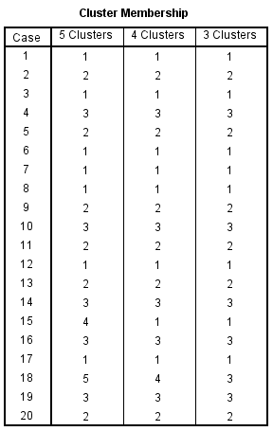
Cluster Membership

Slide 41
Wk 7 Bite 1
10 minute break

Slide 42
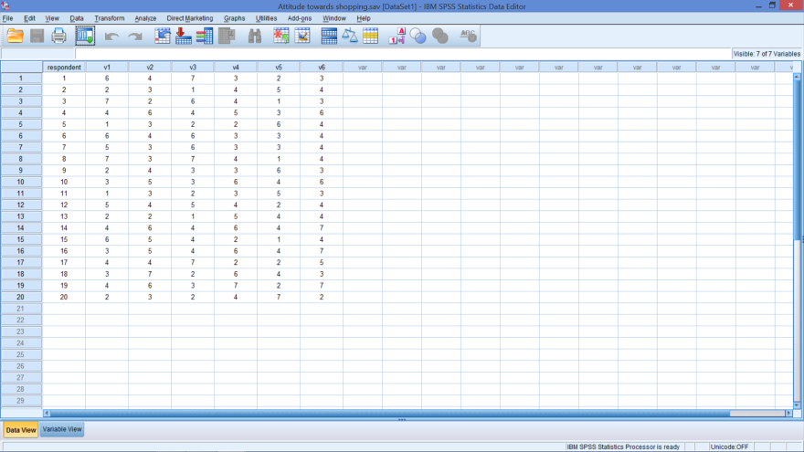
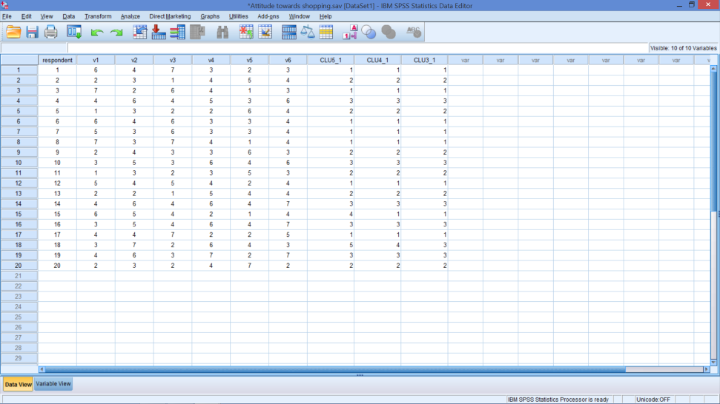
Attitudes towards Shopping
Beginning Data
Ending Data
Notes:
3 new columns of data
These correspond to the cluster membership table just shown
The _1 in the column heading (variable name) indicates the 1st time the analyses ran

Slide 43
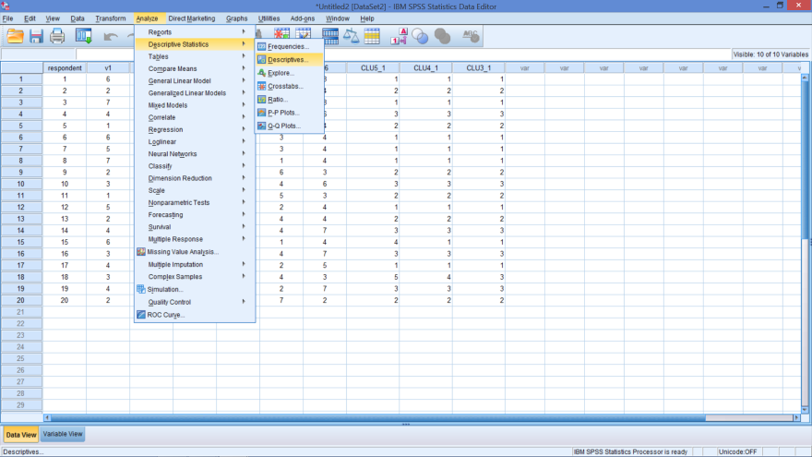
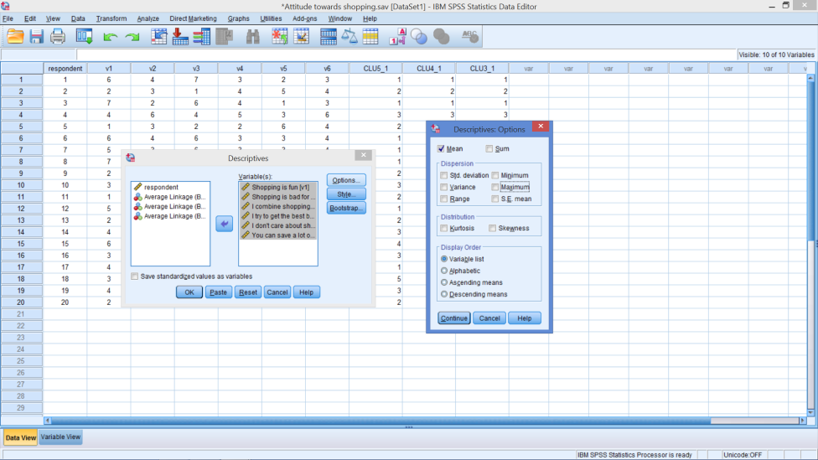
Get Overall Means
Notes:
Analyze → Descriptive Statistics → Descriptives…
Variables: V1 – V6
In Options box: Just tick mean (untick others)

Slide 44
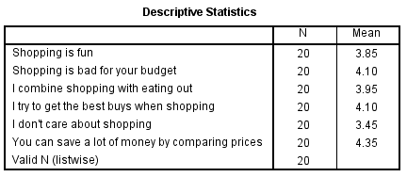
Overall Means

Slide 45
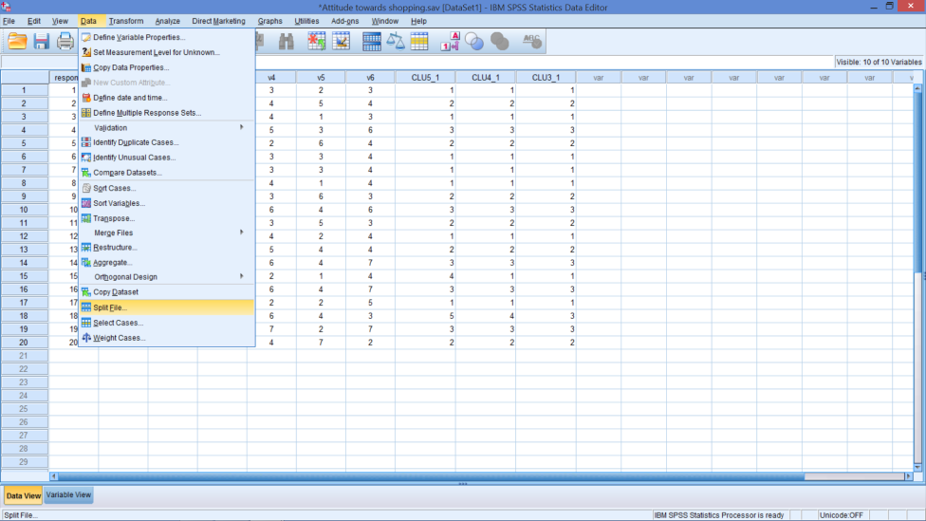
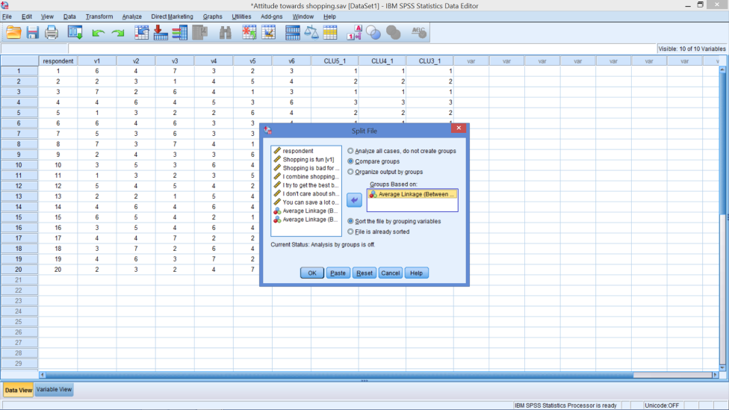
To Get Cluster Means - Split File On
Cluster Membership with 3 segments (clusters)
Notes:
Data → Split File
Tick: Compare Groups
Insert Cluster Membership with 3 Segments (Probably last row)

Slide 46
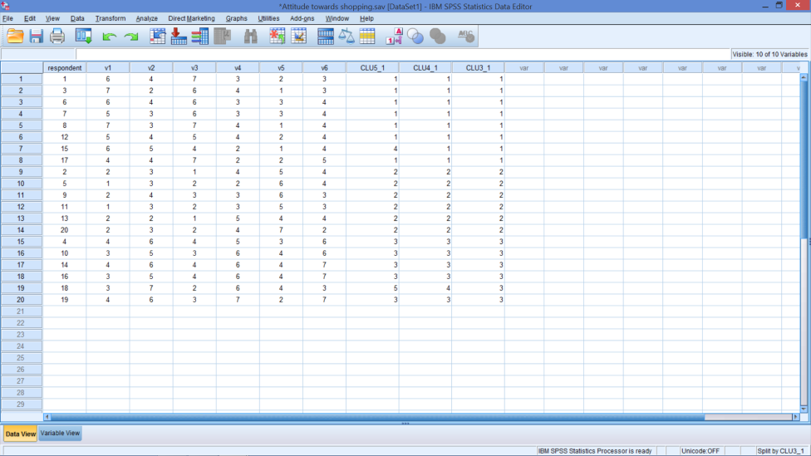
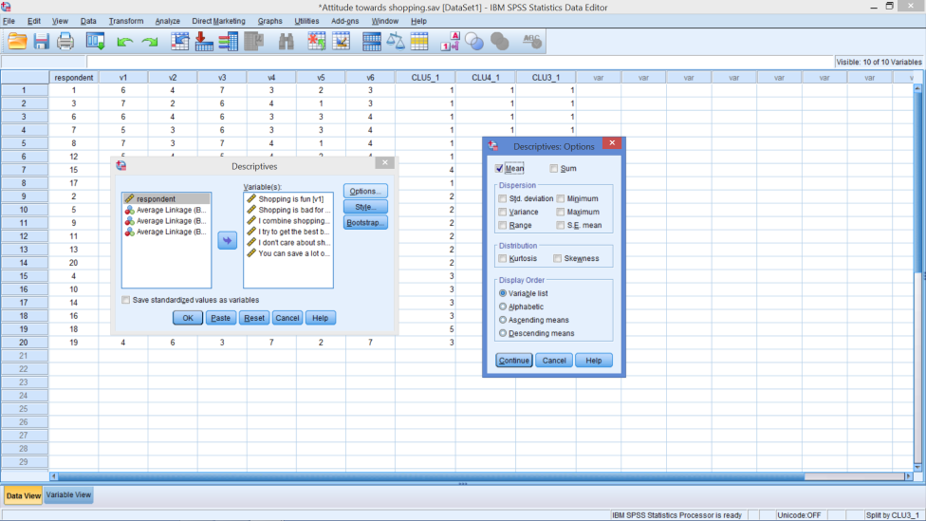
Get Means By Cluster

Slide 47
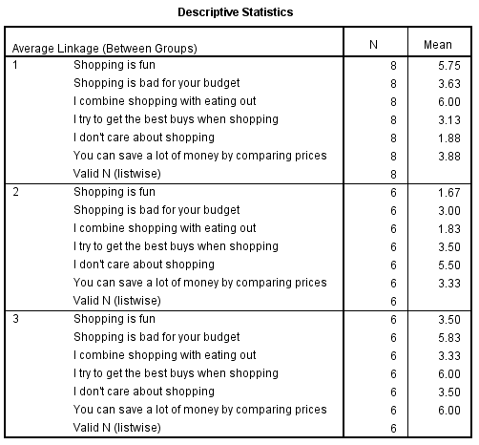
Output Table

Slide 48
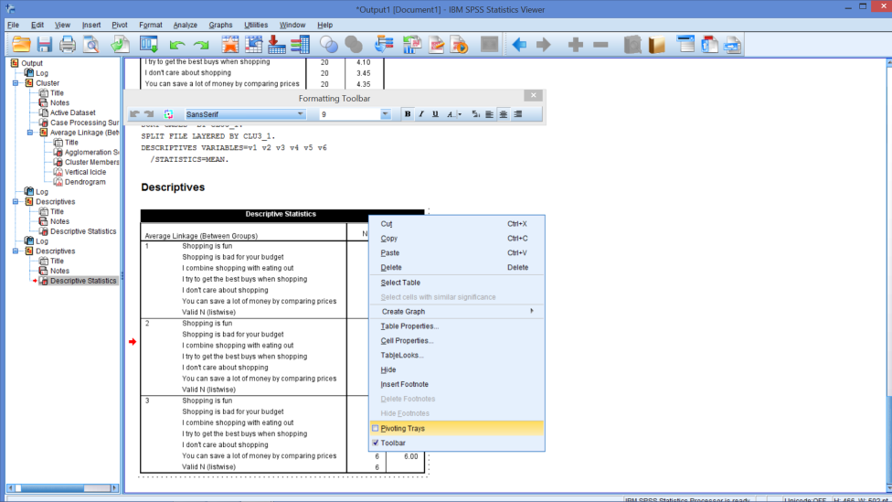
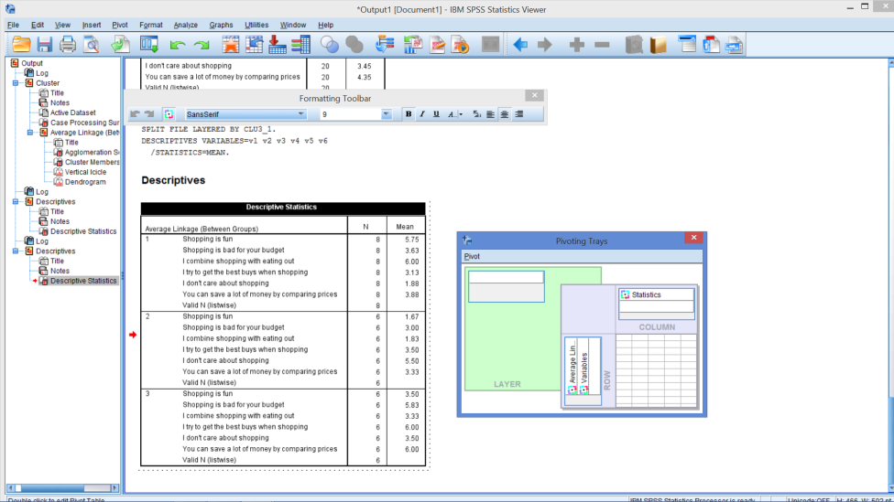
Open Pivot Trays
Notes:
There are many edits you can do once you double click on the table such as resetting columns widths, which I often do so the tables fits on the slides better.
Double click on table
See broken border
Right click
Select pivot trays

Slide 49
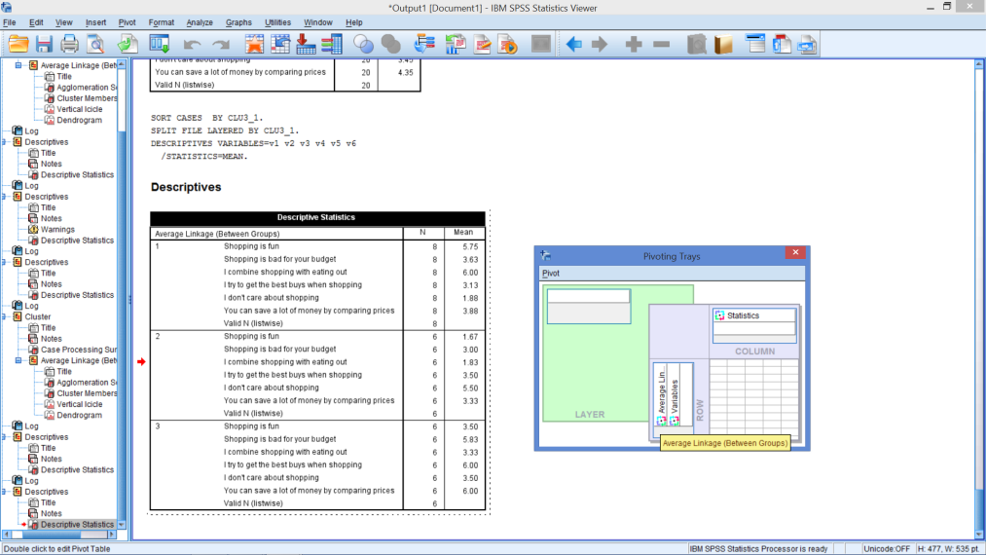
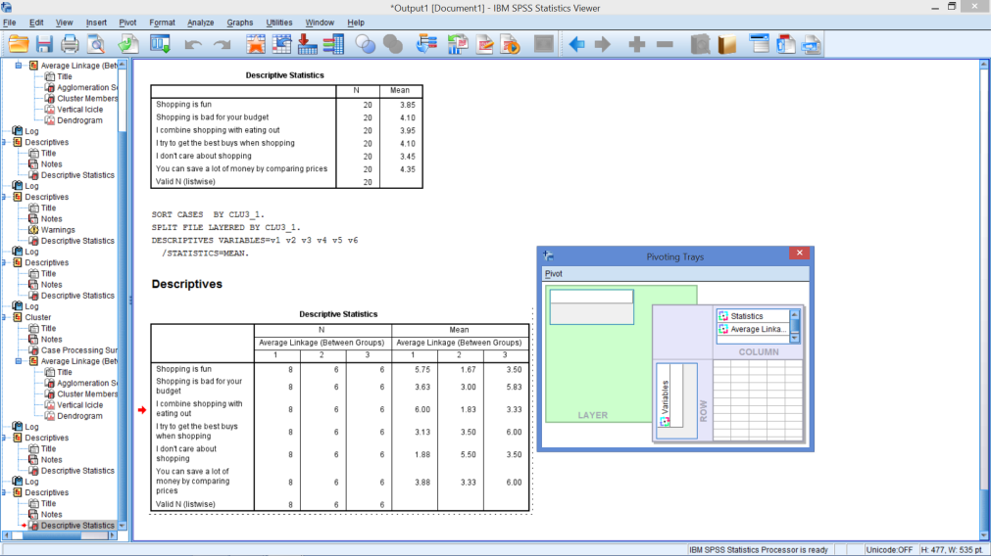
Move Cluster Membership to a Column
Notes:
Click on the colorful circle next to ‘Average Linkage’
Drag and drop it under ‘Statistics’

Slide 50
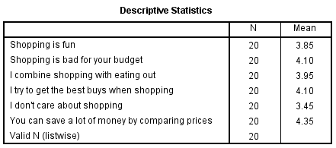
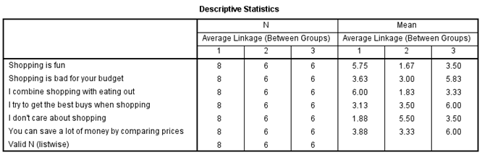
Overall Means

Slide 51

Are the clusters different?
Notes:
Step 1: Look across each row
Which segment has the highest value for each attribute?
Which segment has the lowest value for each attribute?
Which segments have means very similar to group average?
Which segments have means very different from the group average?
Step 2: Look down each column
What is similar about members in each segment?
What distinguishes one segment from another?
Name each segment
Interpretation involves examining the distinguishing characteristics of each cluster’s profile and identifying substantial differences between clusters
Cluster solutions failing to show substantial variation indicate other cluster solutions should be examined
If the clusters don’t appear different, then look at 2 or 4 clusters.

Slide 52
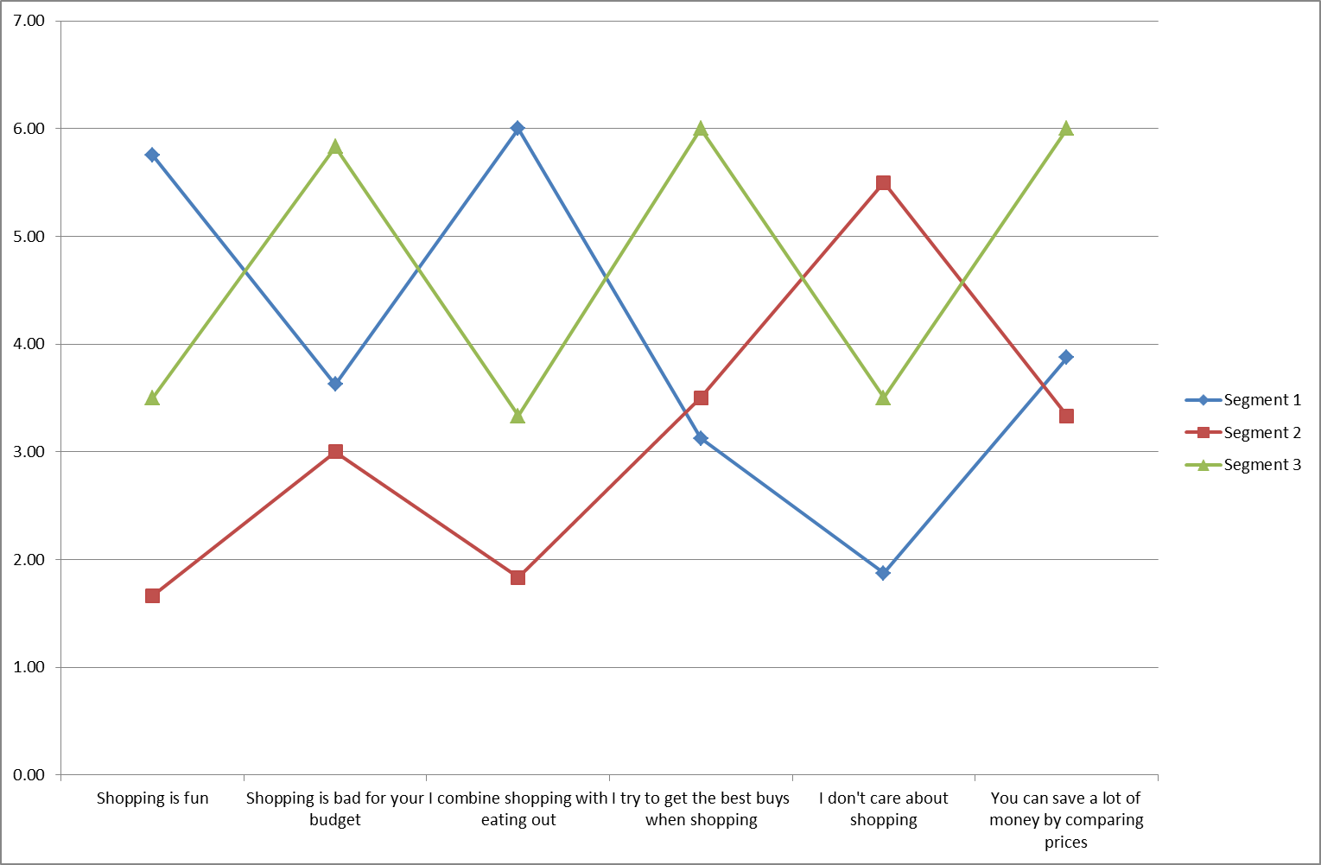
Visually See How Segments Differ
Notes:
This line chart is also called a snake plot.

Slide 53
Create 2 More Means Tables
4 Clusters
5 Clusters
Change Split File
4 Clusters
Rerun Means
Pivot the table
Change Split File
5 Clusters
Rerun Means
Pivot the table

Slide 54
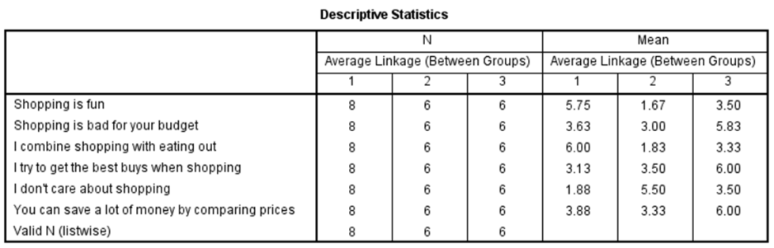
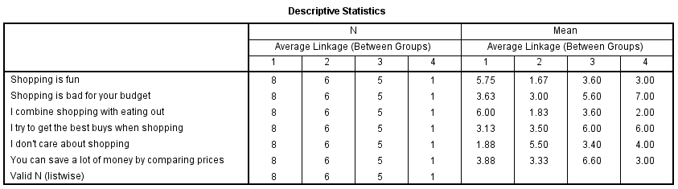
Comparing Means Tables
Notes:
Single-member or extremely small clusters are generally not acceptable and should generally be eliminated.

Slide 55
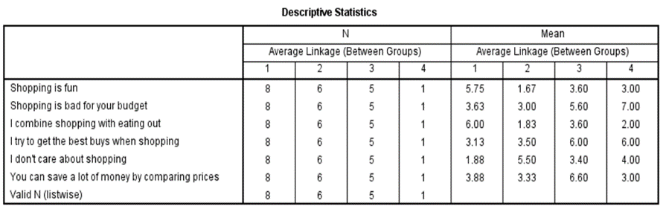
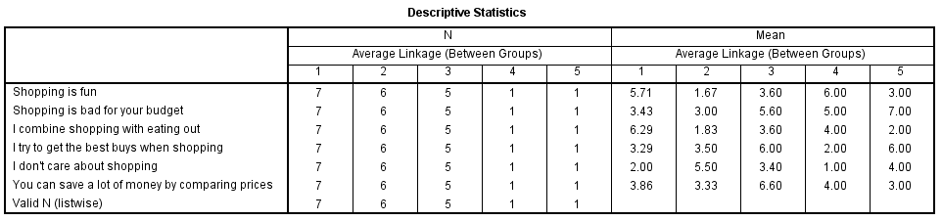
Compare 4 to 5 – if necessary

Slide 56
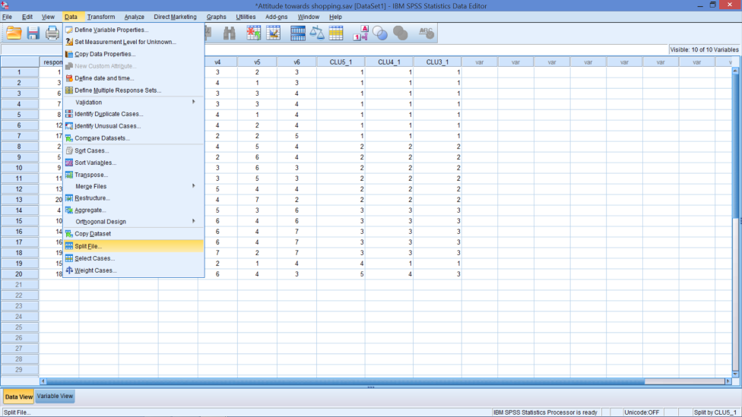
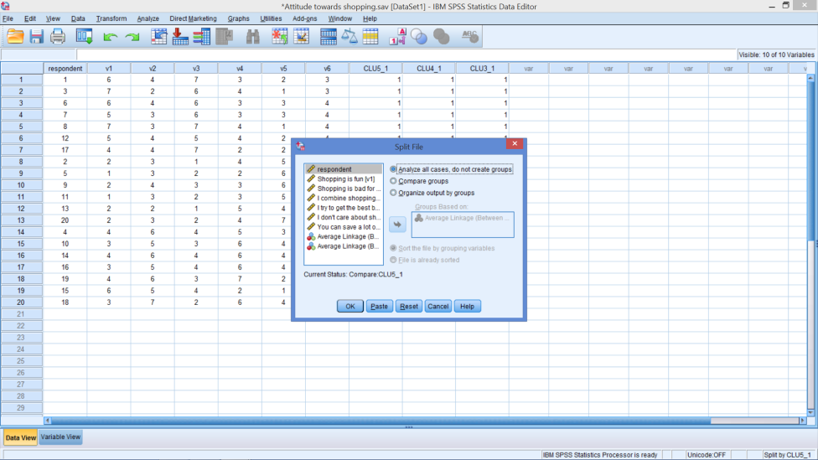
To Turn Off Split File

Slide 57
Conducting Cluster Analysis
1
2
3
6
4
5
Formulate the problem
Select a distance measure
Select a clustering procedure
Decide on the number of clusters
Interpret and profile the clusters
Assess the validity of the clustering
Notes:
Interpreting and profiling clusters involves examining the cluster means (centroids). The centroids enable us to describe each cluster by assigning it a name or label.
It is often helpful to profile the clusters in terms of variables that were not used for clustering (using discriminant analysis). These may include demographic, psychographic, product usage, media usage, or other variables.

Slide 58
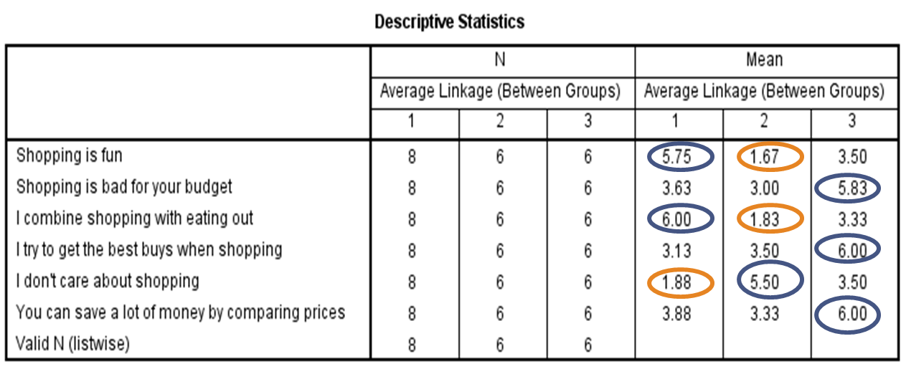
Can you name each cluster?
Notes:
Interpreting and profiling clusters involves examining the cluster centroids (means). The centroids enable us to describe each cluster by assigning it a name or label.
Cluster solutions ultimately must have theoretical validity assess through external validation.
Finally, create names for each segment
Cluster 1:
Cluster 2:
Cluster 3:

Slide 59
Conducting Cluster Analysis
1
2
3
6
4
5
Formulate the problem
Select a distance measure
Select a clustering procedure
Decide on the number of clusters
Interpret and profile the clusters
Assess the validity of the clustering
Notes:
Here are some methods of validating the cluster solution:
Perform cluster analysis on the same data using different distance measures. Compare the results across measures to determine the stability of the solutions.
Use different methods of clustering and compare the results.
Split the data randomly into halves. Perform clustering separately on each half. Compare cluster centroids across the two subsamples.
Delete variables randomly. Perform clustering based on the reduced set of variables. Compare the results with those obtained by clustering based on the entire set of variables.
In nonhierarchical clustering, the solution may depend on the order of cases in the data set. Make multiple runs using different order of cases until the solution stabilizes.

Slide 60
Partitioning Method: K-means
Cluster center
Predetermined # of segments
Move centers & borders
Minimize a
a = distance from respondent to cluster center
Maximize b
b = distance between centers
= distance from I to III
= distance from I to II
= distance from II to III
Cluster border
•
•
III
•
•
Dimension 2
•
b
b
I
•
•
b
•
•
a
•
•
•
II
Dimension 1
One respondent
Notes:
36
36

Slide 61


K-means Clustering
Notes:
Be sure split file is off
Data → Split File
Tick: Analyze all cases, do not create groups
Analyze → Classify → K-means Cluster…
Move V1 – V6 to variables box
For Number of Clusters: Insert number from hierarchical clustering decision (3)

Slide 62


K-means Clustering
Save Box
Options Box
Notes:
Save Box: Tick Cluster membership
Options Box: Tick ANOVA table

Slide 63

K-means Clustering

Slide 64


To Show More Decimal Places
Notes:
Tables may not show 2 decimal places.
If you want more places to show:
Double click on table
Find Cell Properties
Find Format Values
Click on Number
Set Decimal places to 2

Slide 65

Final Clusters
Notes:
Tables may not show 2 decimal places.
If you want more places to show:
Double click on table
Find Cell Properties
Find Format Values
Click on Number
Set Decimal places to 2

Slide 66

What can you infer from this table?
Notes:
The ANOVA compares the means within each segment for each variable.
What does it mean when Sig. is < 0.05?

Slide 67


K-Means: Turn On Split File

Slide 68

Overall Means

Slide 69


Compare Clustering Output
Average Linkage
K-means

Slide 70
Cluster Analysis …
is descriptive
is totally dependent upon the variables used
will always create clusters
Notes:
Cluster analysis is descriptive, atheoretical, and noninferential
Will always create clusters, regardless of the actual existence of any structure in the data.
The cluster solution is not generalizable because it is totally dependent upon the variables used as the basis for the similarity measure.

Slide 71

In-class Exercises try the questions using data sets; 1) Nike.sav 2)Outdoor.sav

Slide 72
Assessments
Following Week – Class time
Group Assessment
Teams set?
Next Week – Class time
Questions?
Future Work time

Slide 73
WEEK 7 END of BITE 1 to 3
10 minute Break

